Slide 1
Optimizing Sorting Algorithms for GPU

Slide 2
Sorting
… one of the most important algorithmic building blocks in computer science
Two categories of sorting algorithms
Data-driven
the steps of the algorithm depend on the value of the key under consideration : ex Quicksort
in practice they are generally the fastest (best scaling) and
great for CPU implementations

Slide 3
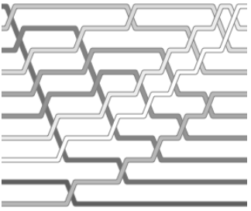

Slide 4
… on GPU ?
Data-independent
they do not change their processing according to the current key value
they always take the same processing path (the operation sequence is completely rigid)
we can exploit this to implement them on multiple processors, because the points at which communication must occur are known in advance

Slide 5
Data independent algorithms
What they do is apply comparator networks to the list, and after a set number of stages of these comparator networks, the list is guaranteed to be in order.
These algorithms cannot be as efficient as data dependent algorithms as they cannot jump out early if the list is already sorted.
For each sorting the same number of operations are performed (best, worst and average cases are all the same).
Perfect for designing electrical circuits to sort some inputs.

Slide 6
Data independent algorithms
Perfect for GPU's, we can parallelize this easily and we don't really need any branching!
The sorting program will run on the fragment processors, which cannot change their output location in memory based on input data values.

Slide 7
Data independent algorithms
These algorithms are good if you don't require a fully sorted list.
You can just stop your algorithm at some intermediate stage.
You will still have a partially sorted list which might be good enough for your application (think graphics).
With the odd-even transition sort, you can just perform extra passes whenever you can (the stages are almost identical).
This is especially effective if the list only has small, incremental updates.

Slide 8
The Odd-Even Transition Sorting Network

Slide 9
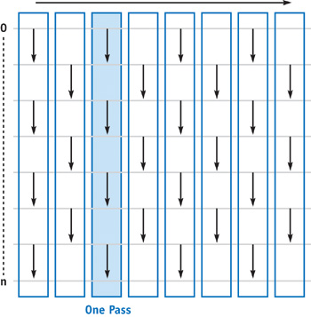

Slide 10
Odd-Even Transition Sorting Network
Each arrow is a Compare-Swap operator, and if the two elements it points to are out of order, they're swapped
The direction of the arrow indicates the desired order
This alternation continues, and allows a high degree of parallelism within a single stage (no overlapping memory accesses)

Slide 11
Implementation on GPU
render to two texture buffers in double-buffer mode.
2) for each pass, draw a full-size quad and execute a fragment program that fetches the key at its fragment's position, fetches the key at its neighbor's position from the source buffer, compares the two keys, and writes the result to the target buffer

Slide 12
Complexity
To guarantee the list is sorted you need N - 1 stages and ~ N/2comparators for each stage - O(n ²)
comparing two keys involves processing two fragments - perform a less-than comparison on the first and a greater-equal comparison on the second
both fragments do two data (texture) fetches

Slide 13
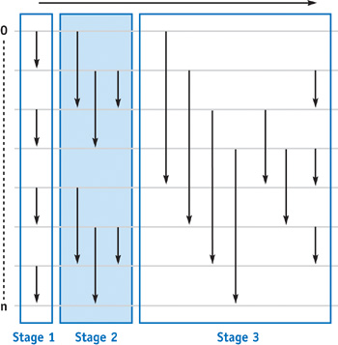
Odd-Even Merge Sorting
sort all odd and all even keys separately and then merge them
stages are then scaled and repeated for all powers of two until the whole field is merged

Slide 14
Complexity
To sort the m keys of a stage, log(m) passes are needed.
For sorting all n keys, log(n) stages are needed, resulting in an overall O(n log²(n) + log(n)) passes

Slide 16
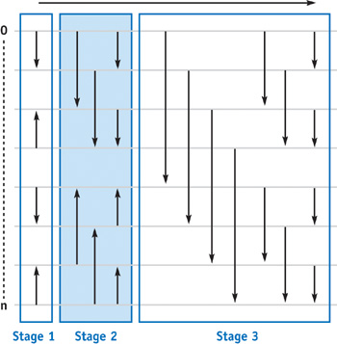
The Bitonic Merge Sorting
Same scaling as odd-even merge sorting networks, but are more efficient
“0-1 principle” - states that if a comparator network sorts 0's and 1's, it will sort anything

Slide 17
Bitonic Merge Sorting
A bitonic sequence is a sequence with at most two transitions between 0's and 1's.
(0,0,0,1,1,1,1,1)
(0,1,1,1,1,0,0,0)
(1,0,0,0,0,1,1,1)
(1,1,1,1,1,1,1,1)

Slide 18
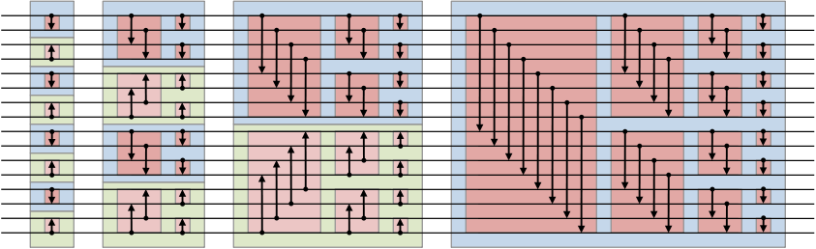
Bitonic Merge Sorting
If the number of elements isn't a power of 2, we cannot use the algorithm as we see it.

Slide 19
Complexity
Same as Odd-Even Merge
O(n log²(n) + log(n))
Can be implemented to use all the GPU resources (fragment unit, vertex unit, rasterization unit)

